Slide 1

NFL ANALYSIS Week 1 Results
JUSTIN NOLAN
RUBY BHATIA
NATHAN ROLLER
DARELL JOHNSON

Slide 2
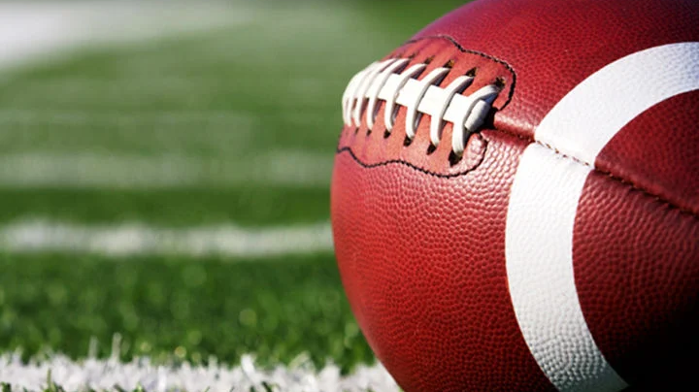
PROJECT FOCUS
This project focuses on analyzing and visualizing NFL Week 1 games from the 2024 season. We leverage data visualization tools to extract insights into team performance, scoring trends, and key statistics. The project provides an interactive platform to explore these aspects using various visualizations and comparisons.

Slide 3

DATA SOURCE
Data Source: NFL Week 1 Game Logs
Link: nflverse-data GitHub

Slide 4

DATA CLEANUP AND EXPLORATION
Handling Missing Values: Filled NaN values using Python (pandas).
Removing Duplicates: Identified and removed duplicates (turnovers) with Python.
Creating Derived Columns: Added win/loss indicators to compare team performance.
Grouping Data: Used Python to group teams by metrics (yards, penalties, turnovers).
Statistical Calculations: Calculated averages and totals using Python (pandas and NumPy).
Sorting Data: Sorted teams by key performance metrics.
Visualization: Created visualizations using Python (matplotlib, seaborn) and JavaScript (D3.js, Plotly).

Slide 5
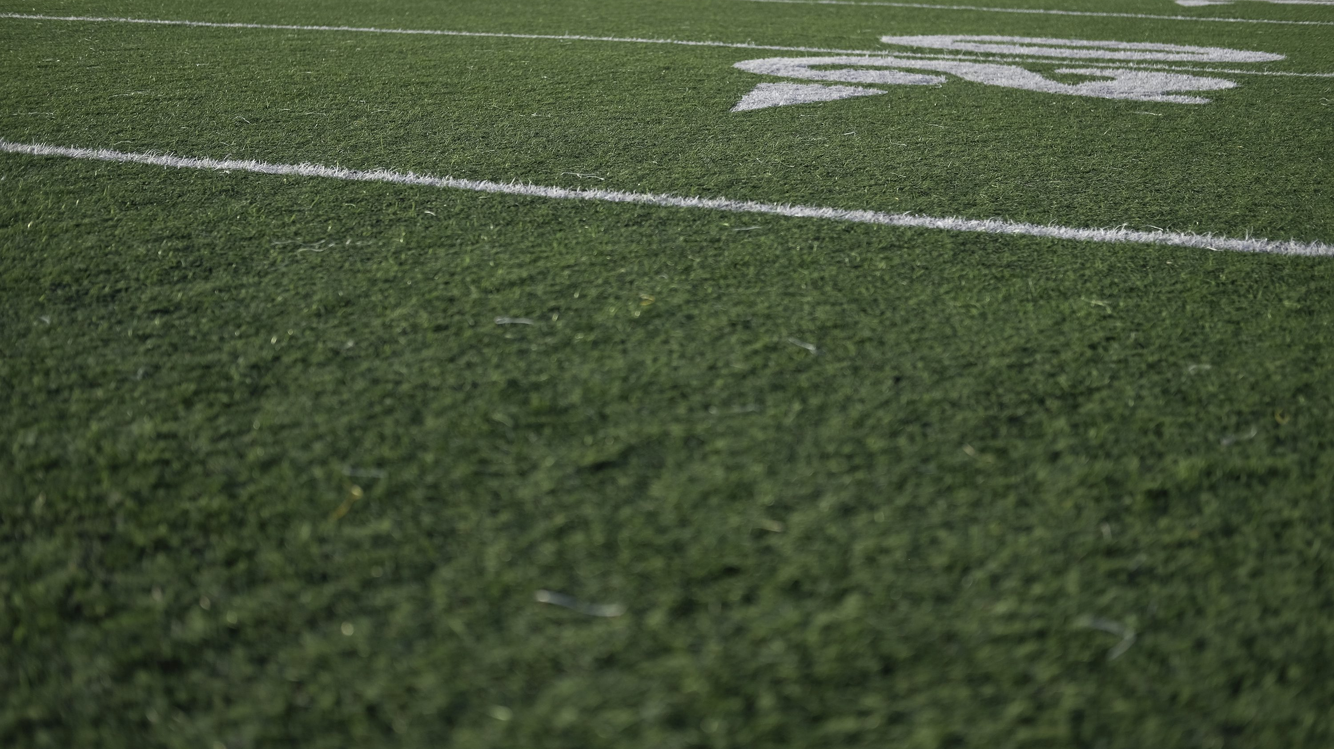
HOW DO TEAMS PERFORM OFFENSIVELY IN NFL WEEK 1 GAMES?

Slide 6
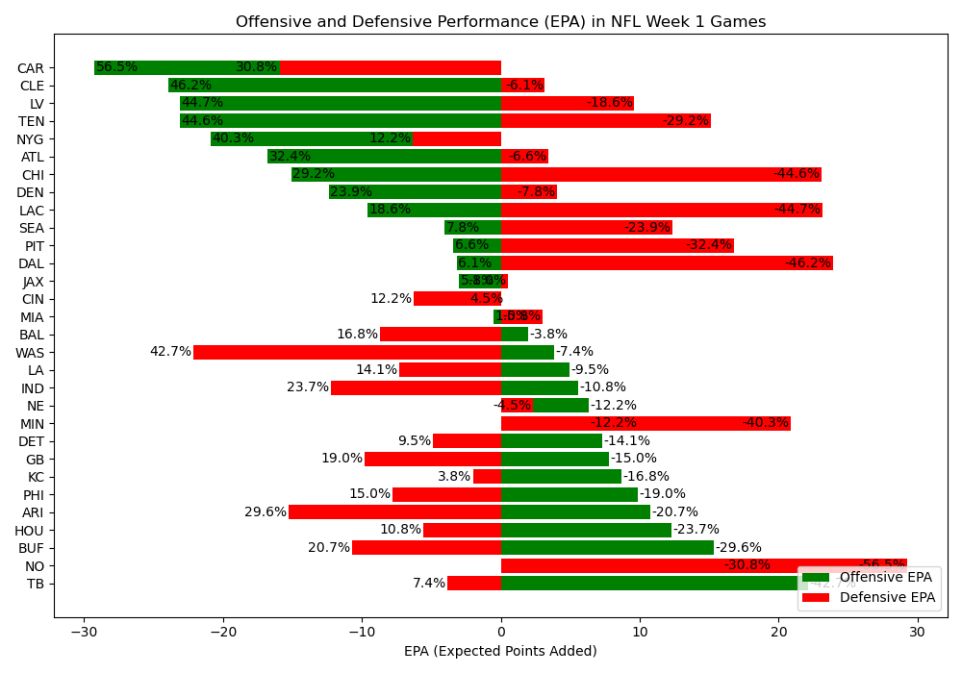

Slide 7
What are tendencies for teams in specific down and distance situations?

Slide 8
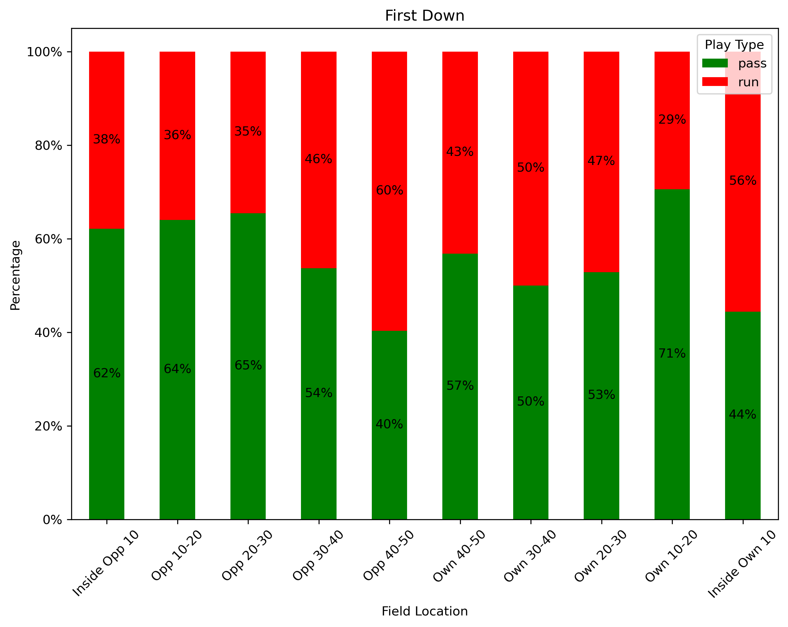
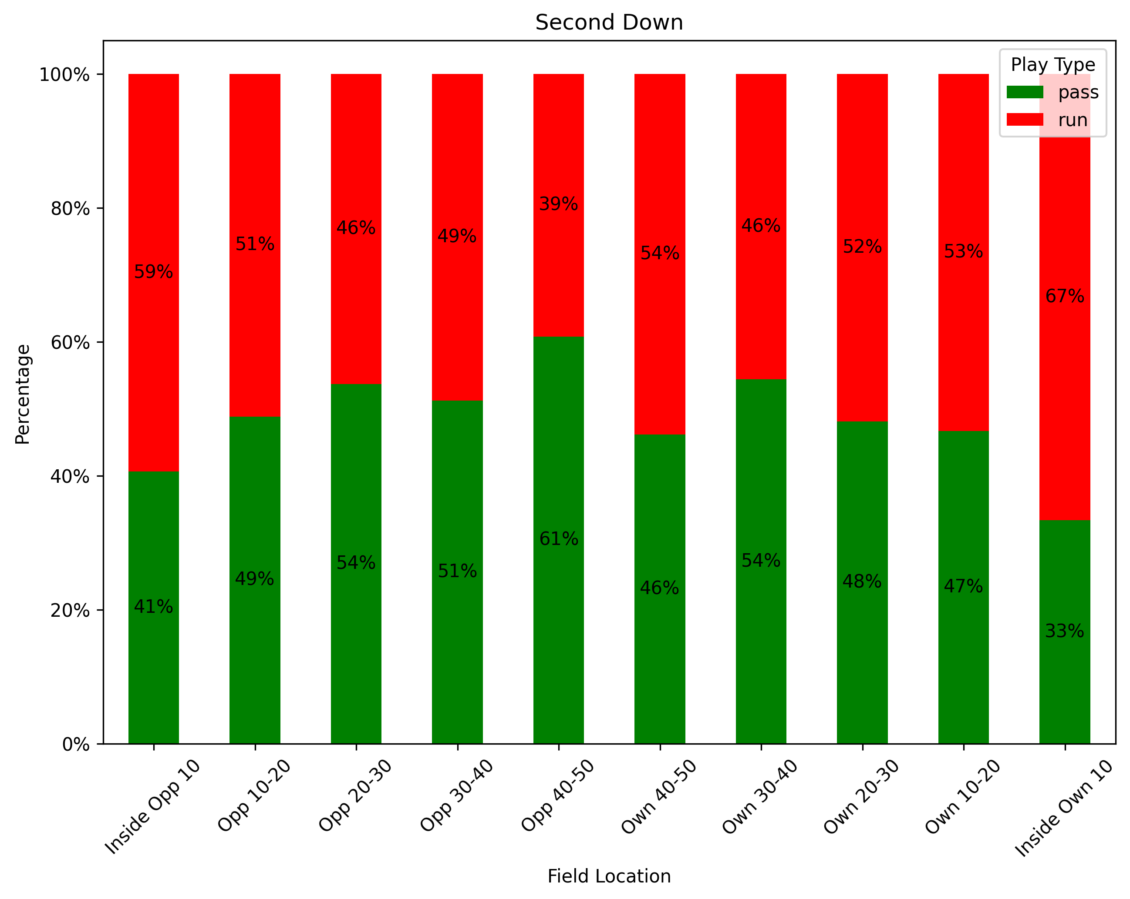
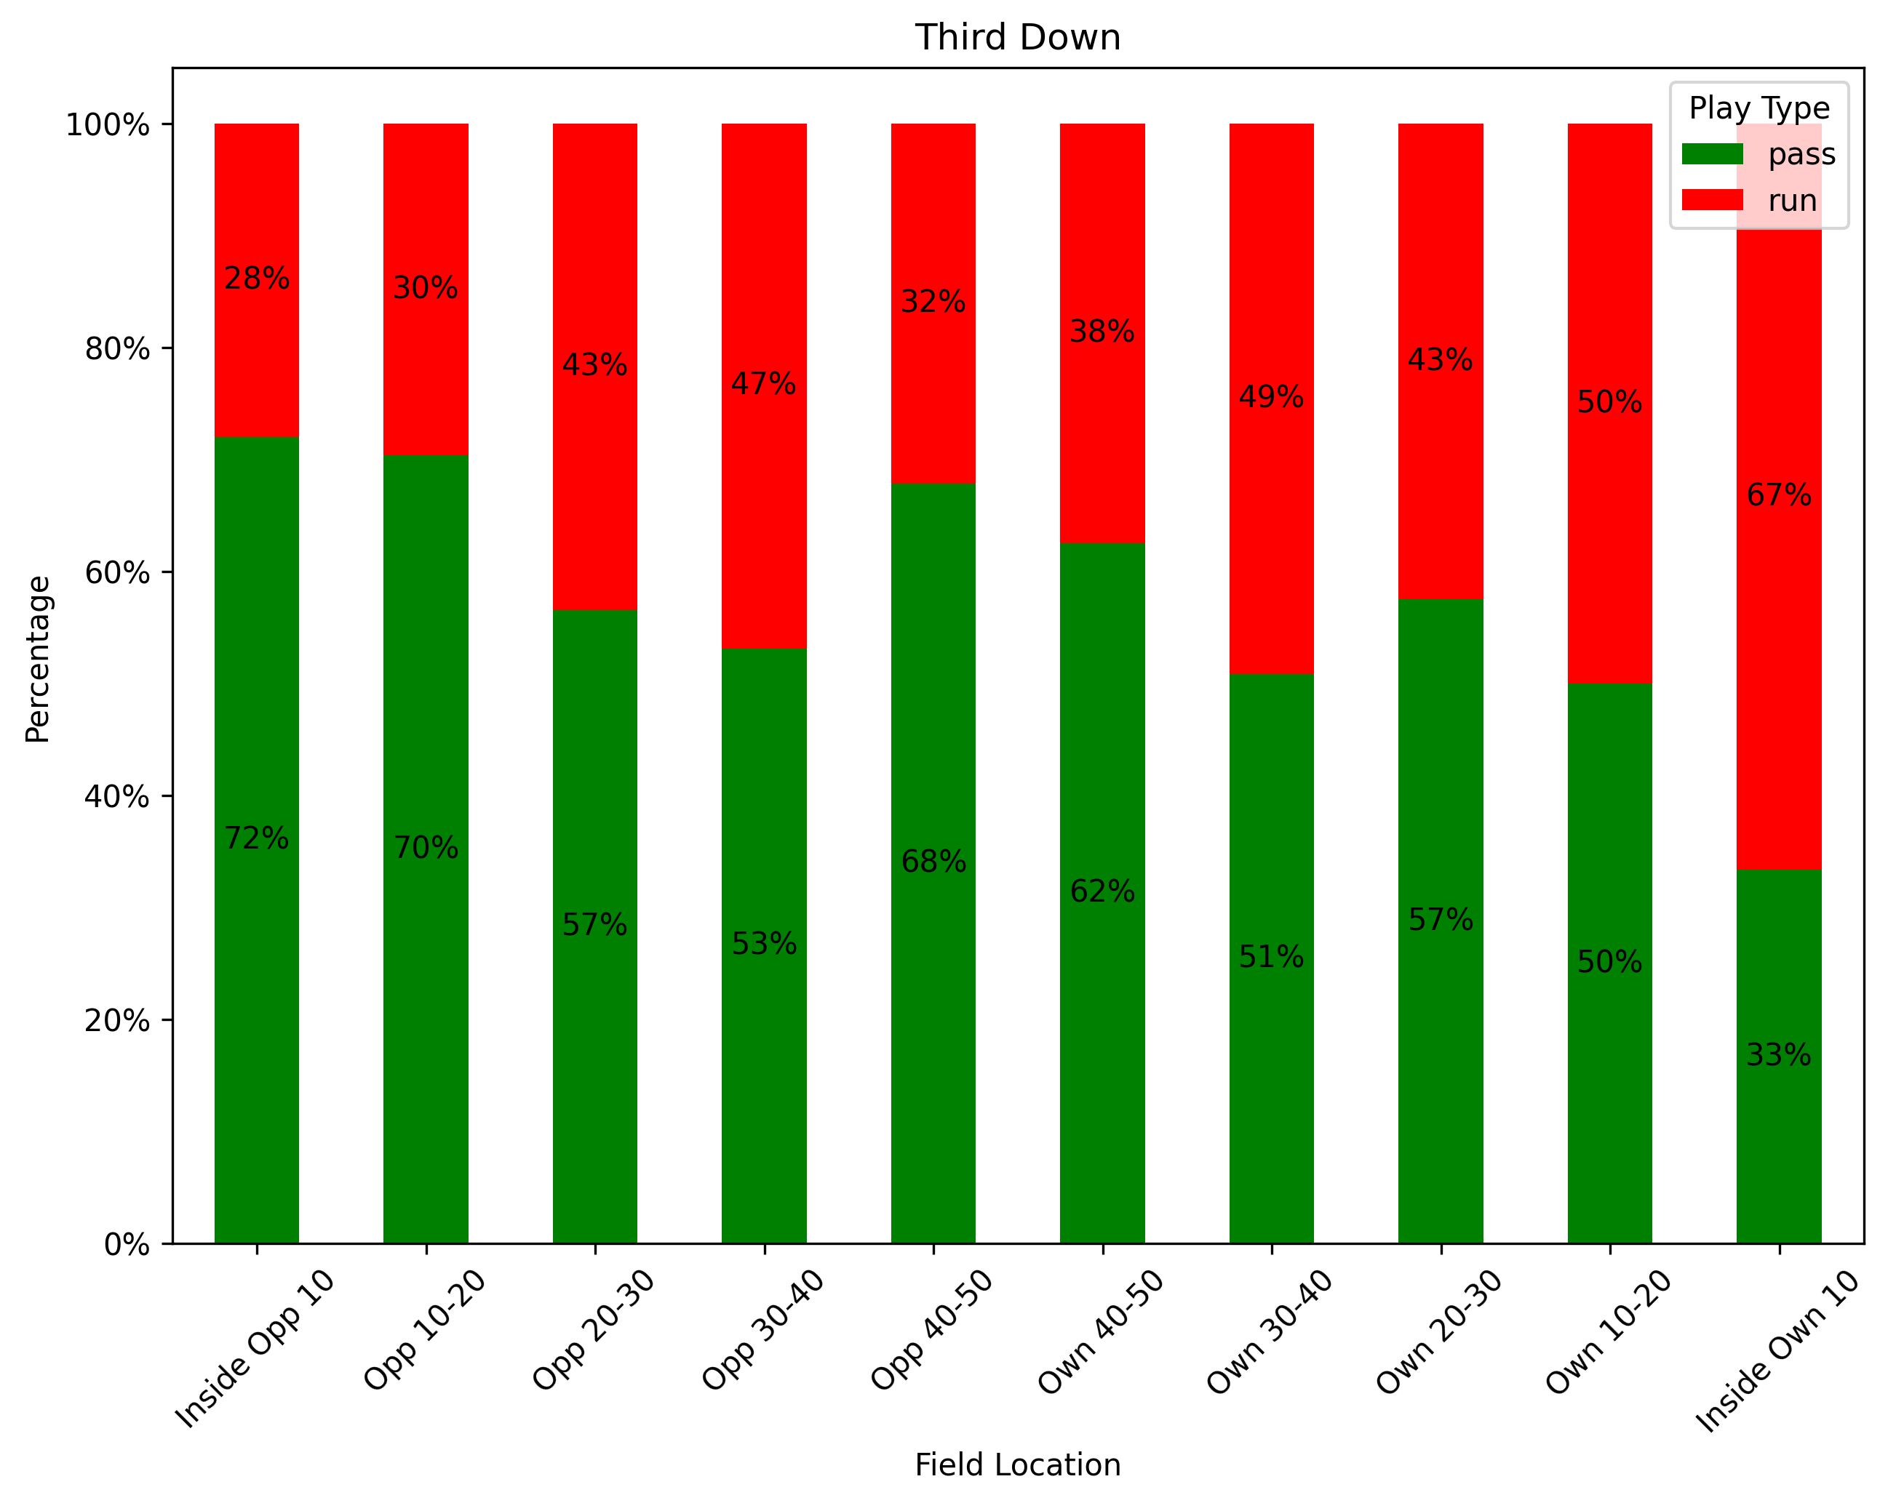
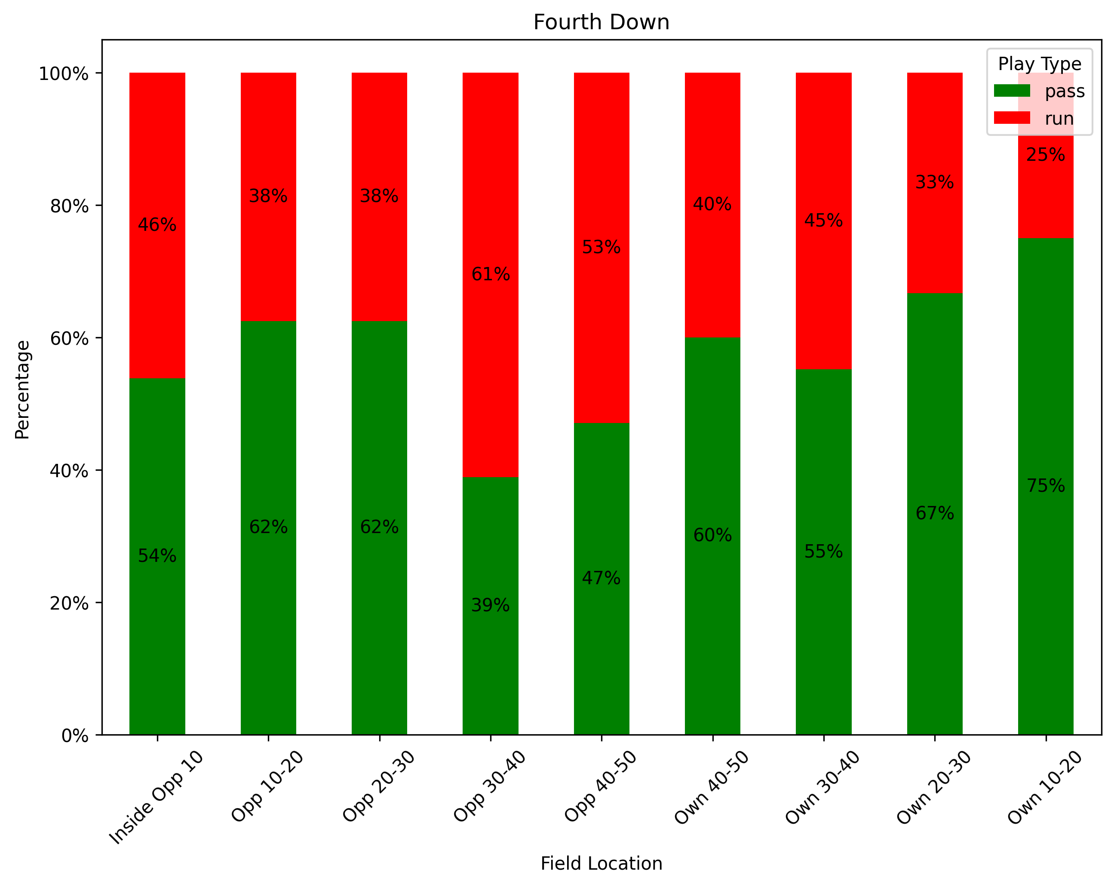

Slide 9
WHAT ARE the conversion rates for possessions downs? What tendencies did you identify?

Slide 10
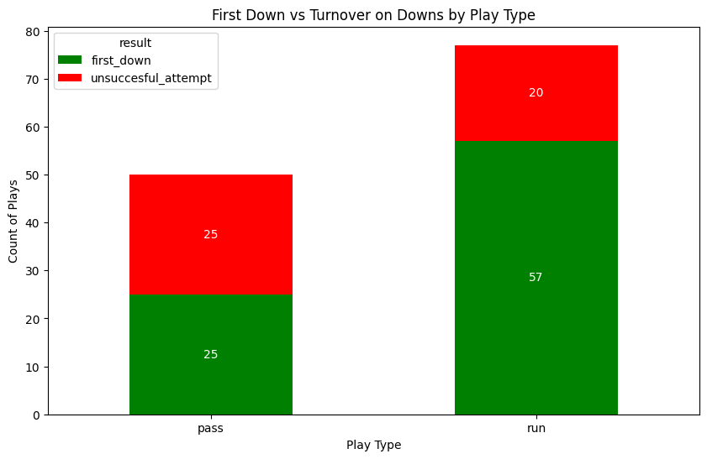
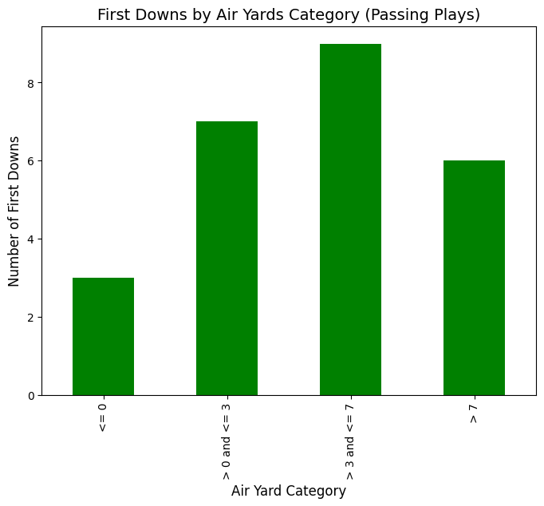
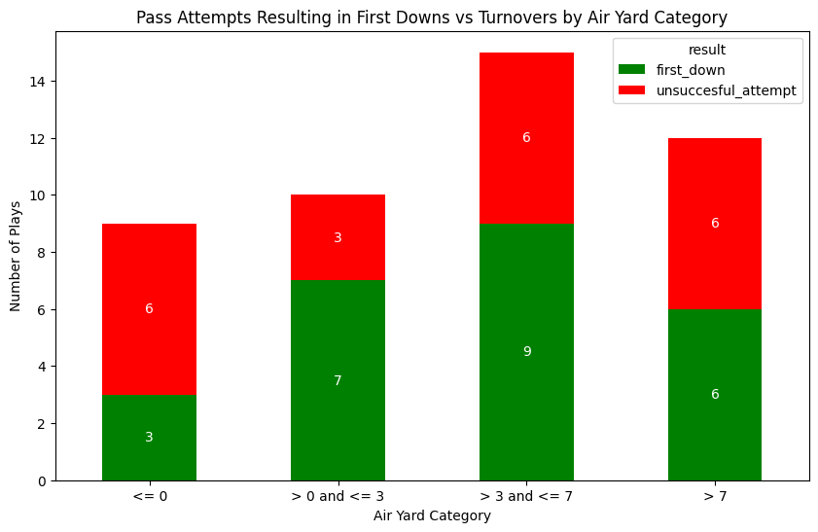

Slide 11
HOW DO DIFFERENT TEAM Statistics correlate with winning outcomes in week 1 games?

Slide 12
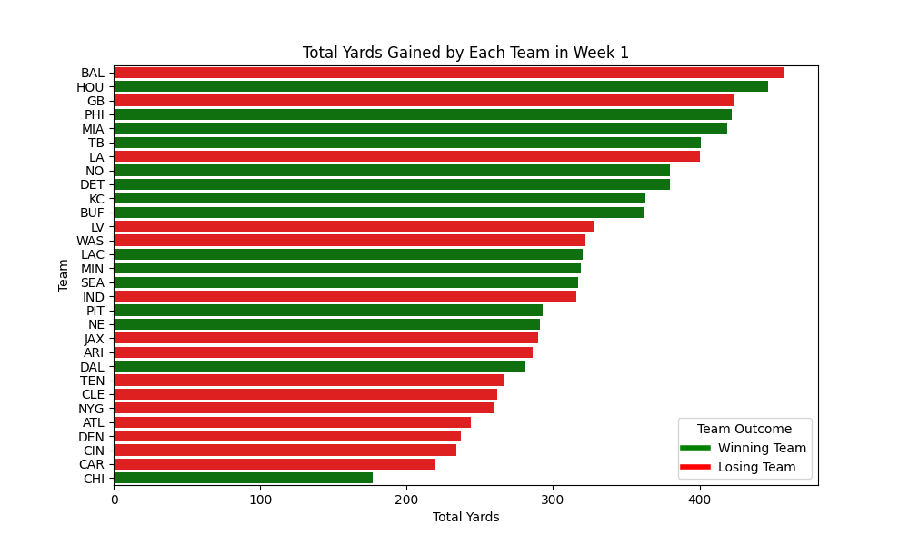
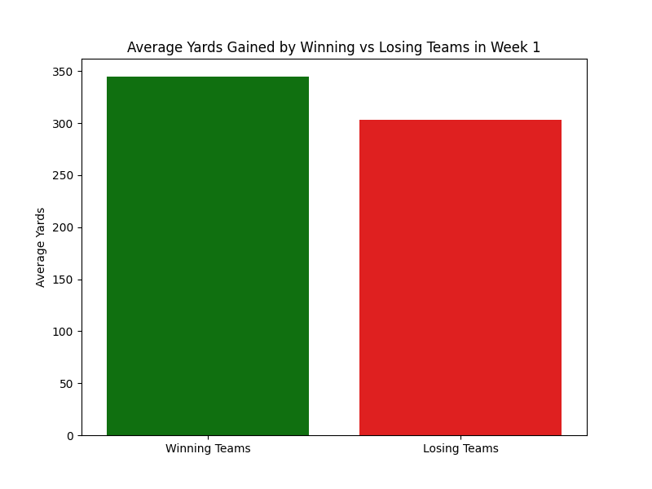
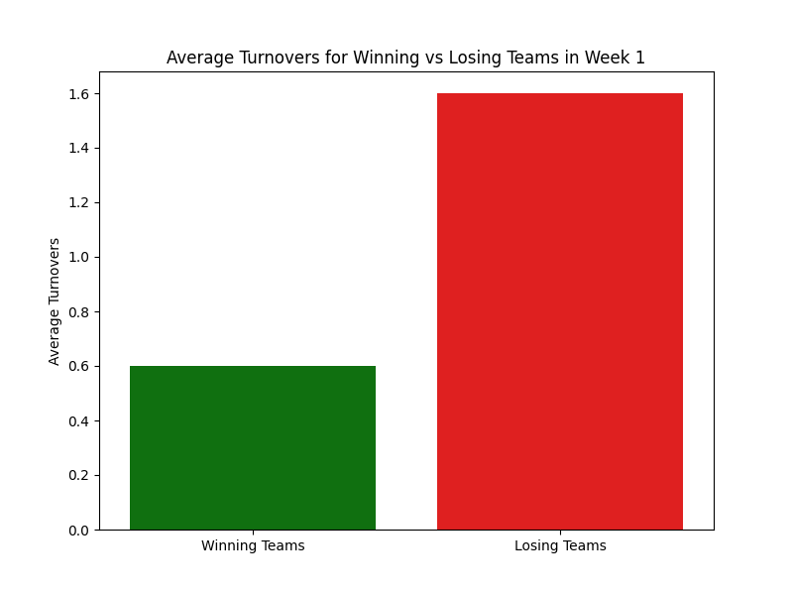
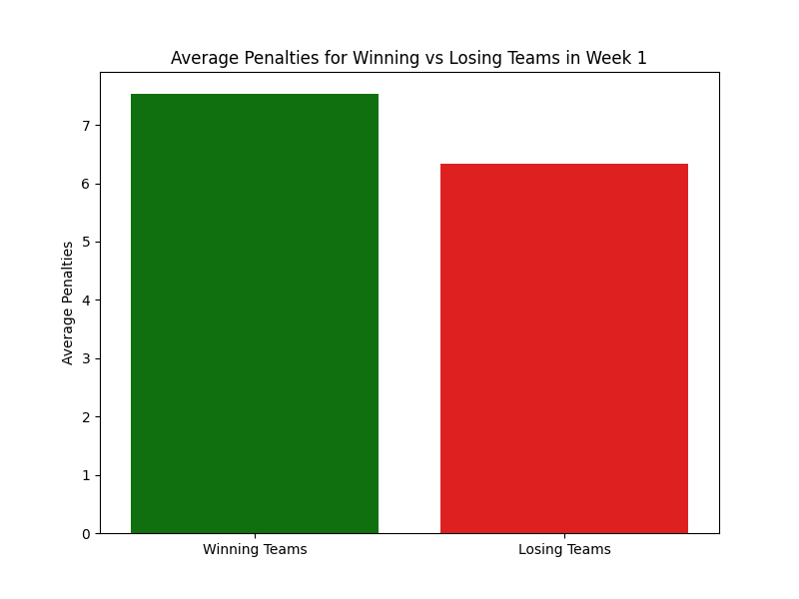

Slide 13
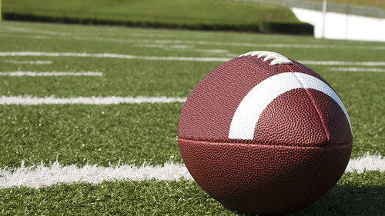
CONCLUSION
Play Type and Risk
Yardage as a Predictor
Discipline in Play
Turnover Avoidance

Slide 14
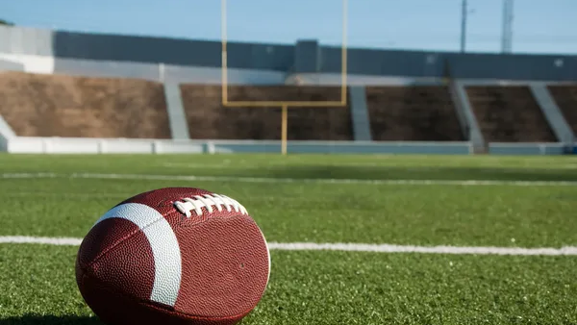
WEBSITE
https://rollernathan.github.io/NFL_2024_Week_1/

Slide 15
THANK YOU

